Slide 1
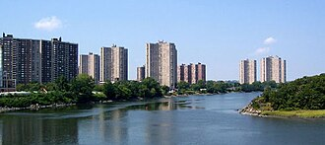
NYC Shooting Data Analysis
Trends, Demographics, and Geographic Patterns in New York City
This Photo by Unknown Author is licensed under CC BY-SA

Slide 2
Purpose of Analysis
Understand
Understand the shooting patterns in NYC
Identify
Identify where and when incidents occur
Explore
Explore the demographic distribution of victims

Slide 3

Data Source
The data came from the NYC Open Data website. The dataset included information about shooting incidents in New York City, such as dates, boroughs, precincts, age groups, sex, and locations.
This Photo by Unknown Author is licensed under CC BY-NC-ND

Slide 4
Research Questions
Which boroughs have the highest shooting rates?
What age/sex/race groups are most affected?
When do shootings most often occur?
What areas can use additional resources?

Slide 5
Data Cleaning and Transformation
Removed missing values
Standardized categories
Converted date/time fields
Created Year and hour variables
Merged Datasets

Slide 6
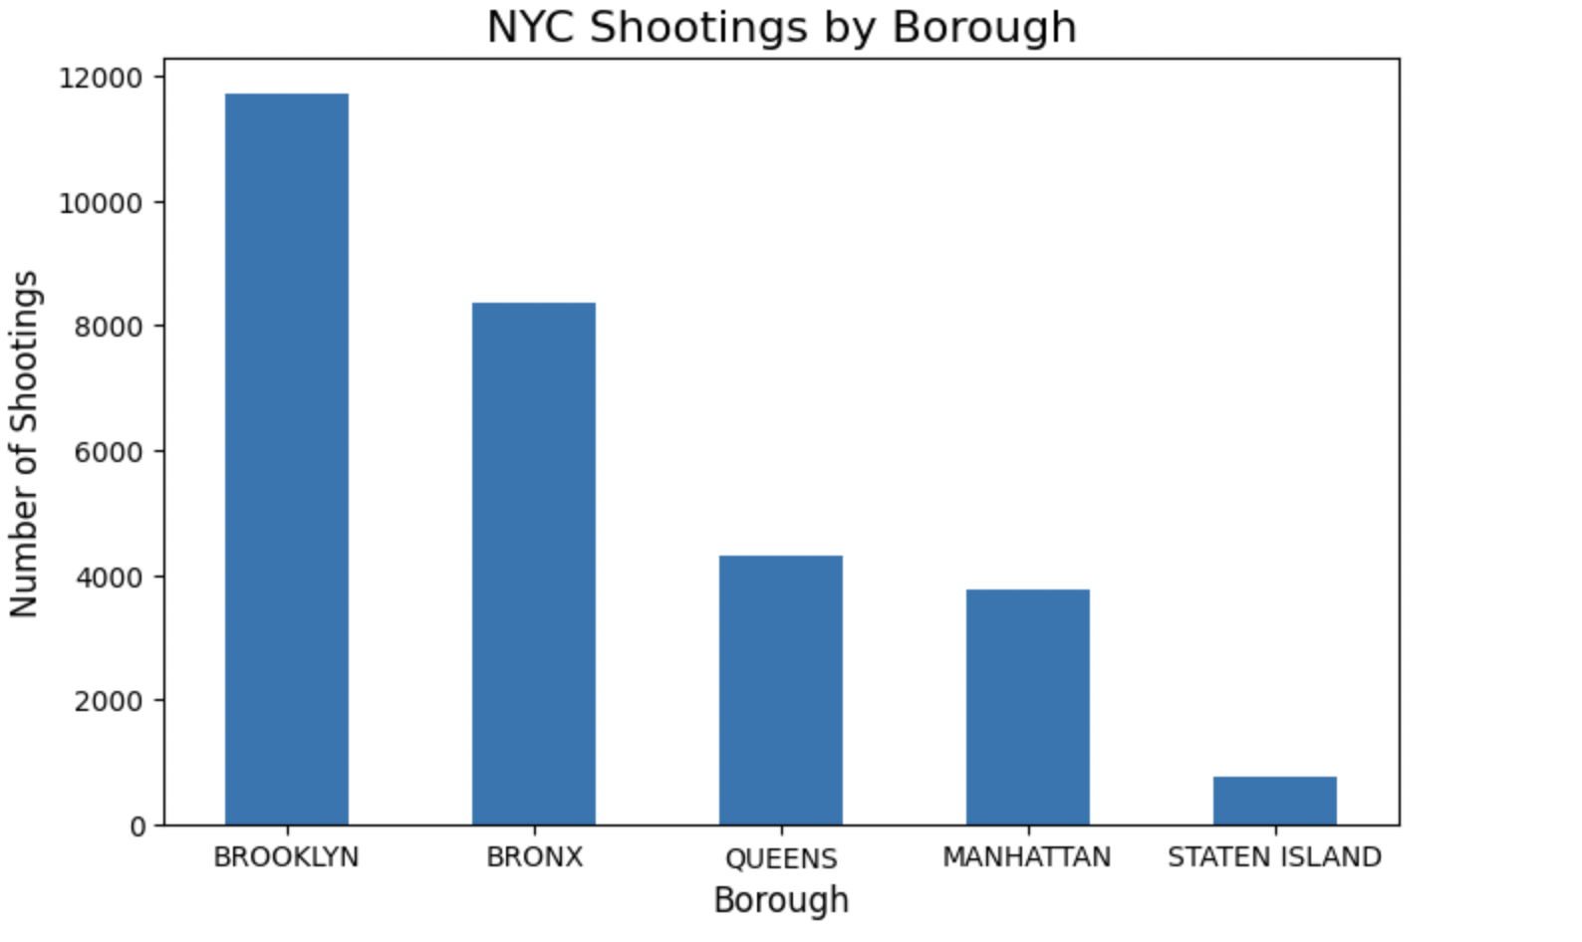
Statistical Analysis
This chart shows a breakdown of reported shootings by borough. The data indicates Brooklyn and the Bronx reported the highest number of shootings, while Queens , Manhattan , and Staten Island reported lower numbers.

Slide 7
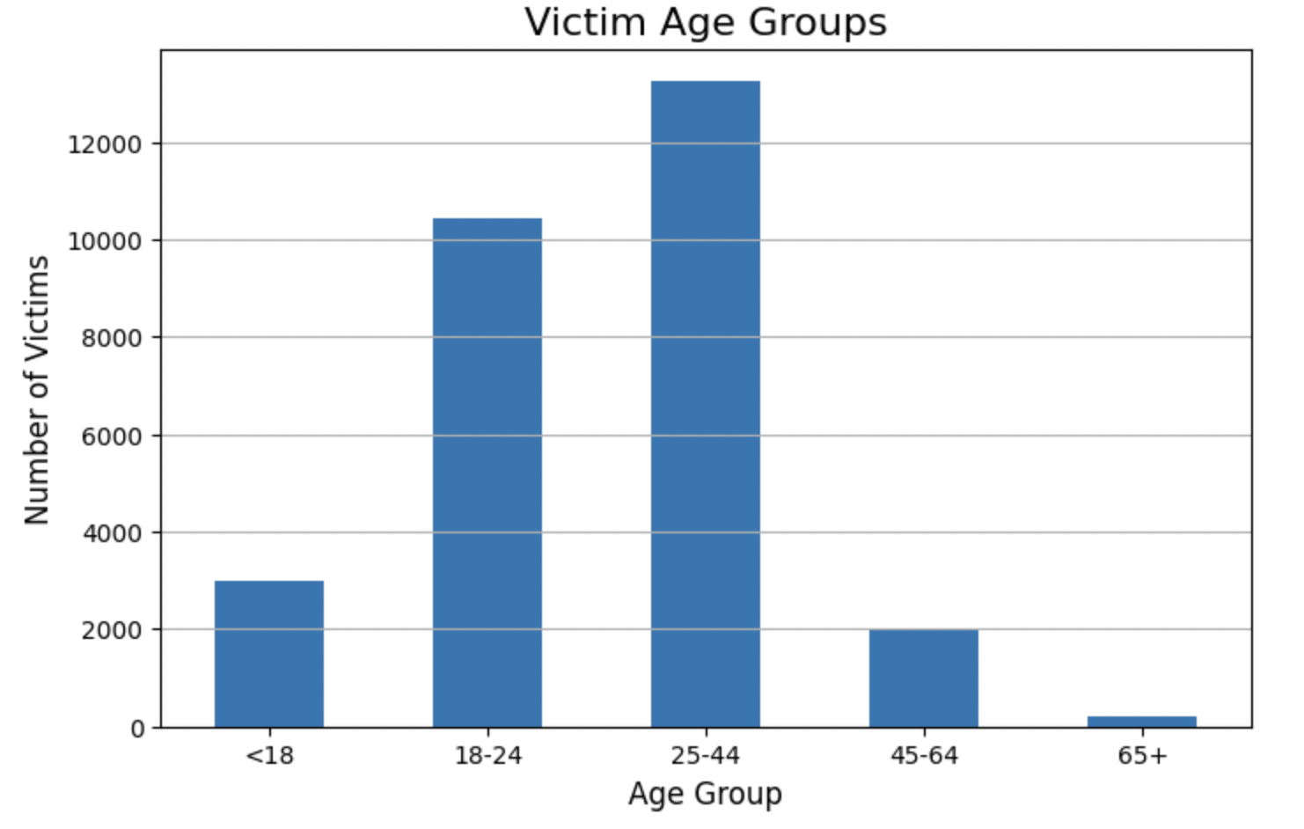
The victim age analysis shows who is most impacted by gun violence. The data indicates the age groups that are most affected by shootings are younger adults (25-44).

Slide 8
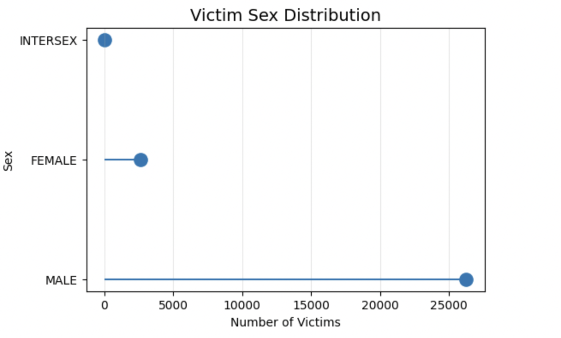
The victim sex distribution shows that males are affected by shootings at a much higher rate than females and intersex individuals.

Slide 9
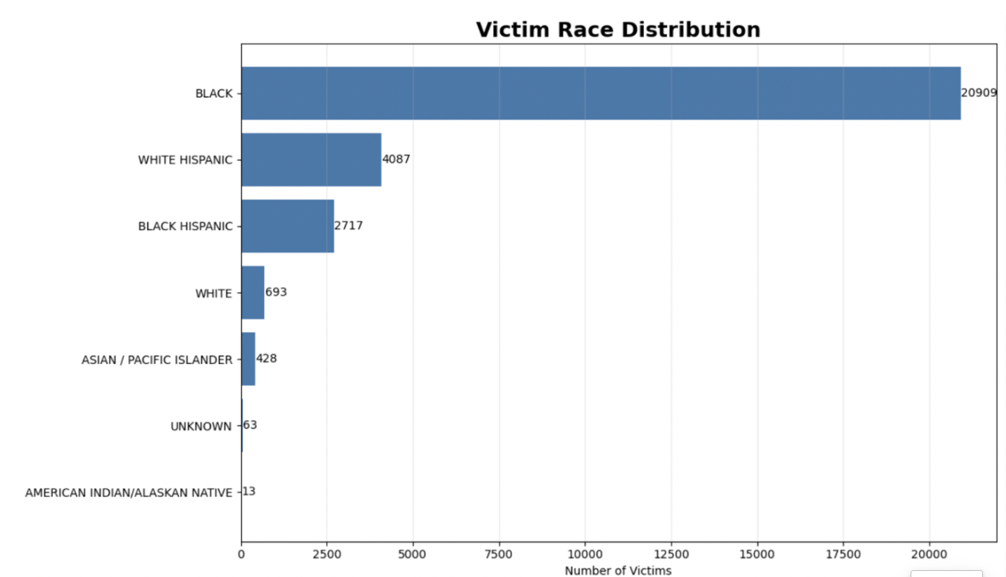
This chart shows the shooting victims by race. Black victims made up the largest number, followed by the Hispanics.
Based on the data from this slide and the 2-3 previous slides, they suggest that there is a need for more community violence intervention programs and support opportunities in Brooklyn and the Bronx. These programs may also want to focus on Black and Hispanic males between the age of 18 and 44.

Slide 10
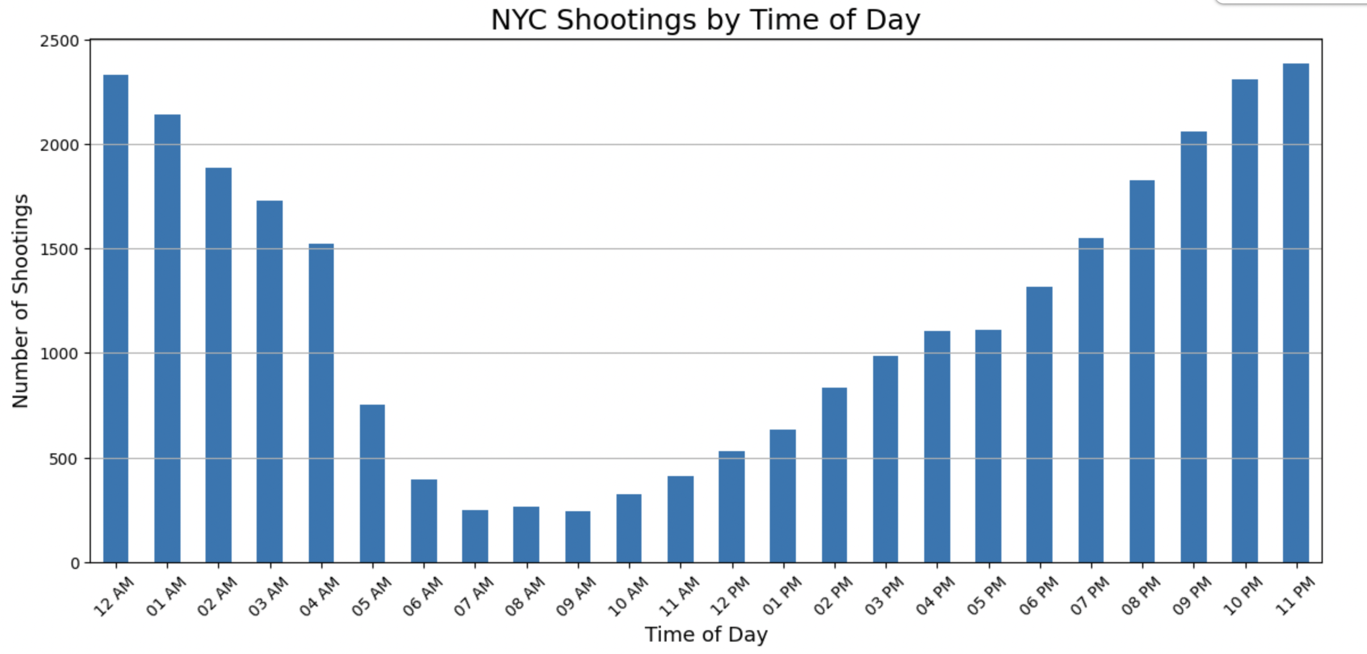
This visualization shows that shootings are more concentrated during evening and nighttime hours, with incidents increasing substantially later in the day. The pattern suggests that maybe additional public safety resources could be considered during those specific hours.

Slide 11
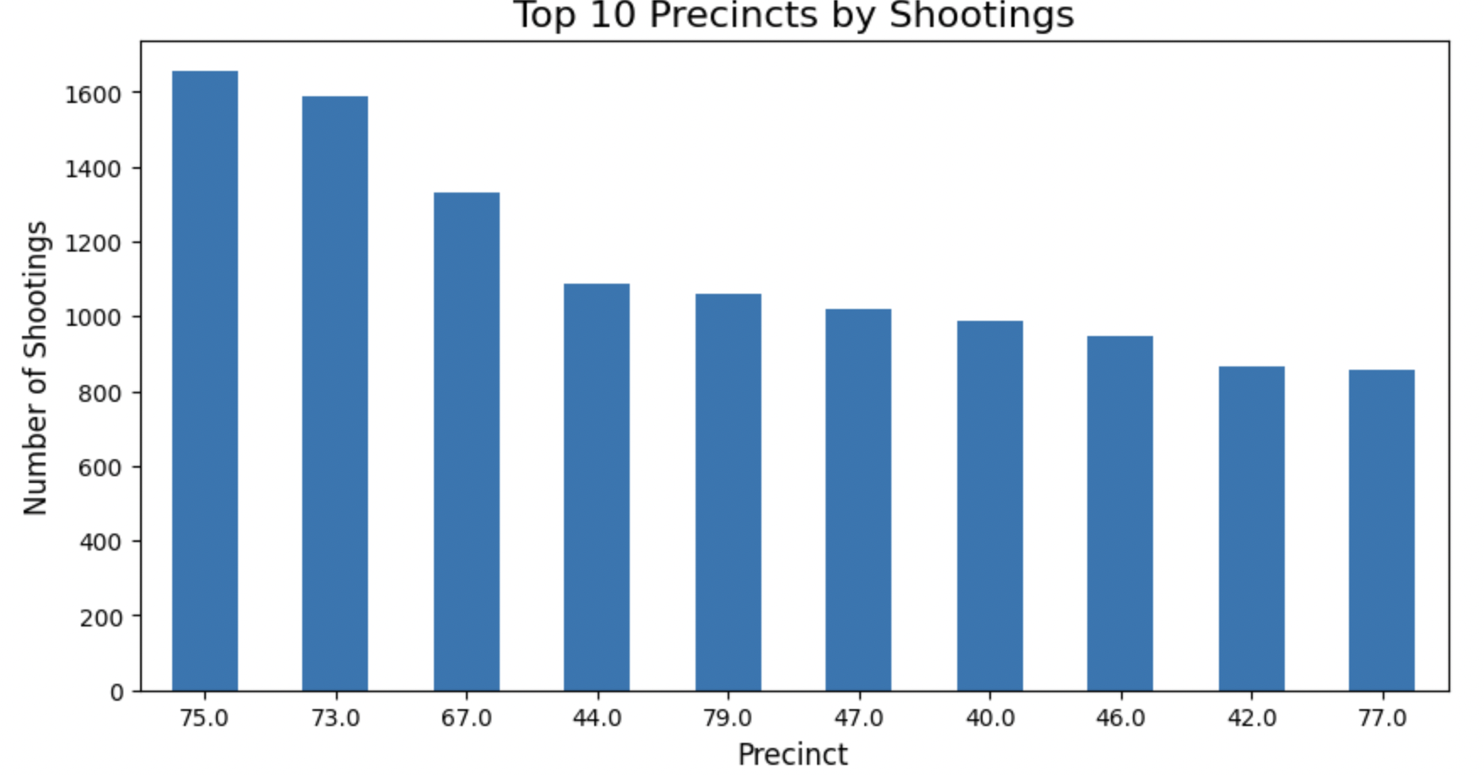
This graph highlights the precincts with the highest number of shooting incidents. The number of incidents within certain precincts again, may suggest areas where additional public safety resources could be considered.

Slide 12
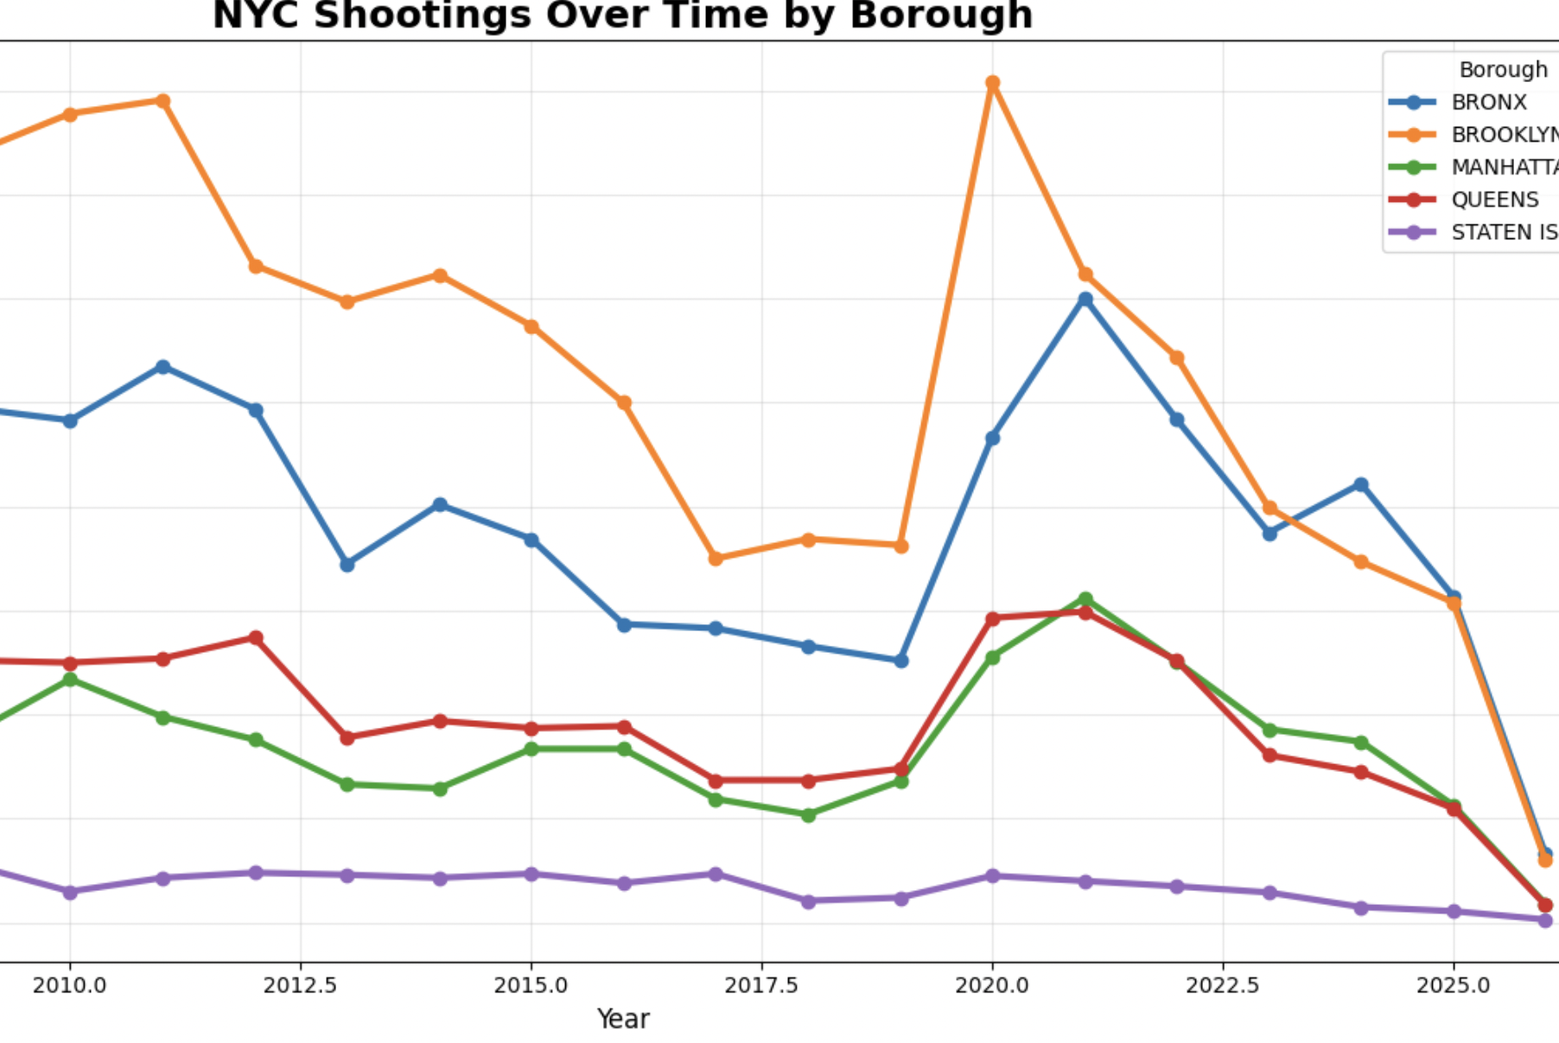
This chart shows how shootings in New York City changed over time across the five boroughs. Brooklyn and the Bronx consistently had the highest number of shootings, with noticeable spikes in certain years, especially around 2020. Manhattan, Queens, and Staten Island generally stayed lower, with Staten Island having the fewest shootings throughout the entire time-period. Overall, the graph shows while trends rise and fall over time, some boroughs experience significantly more gun violence than others.

Slide 13

This data suggests a need for stronger community violence intervention programs and support services focused on males aged 18–44 in Brooklyn and the Bronx, with added emphasis on increased patrols and prevention efforts during evening and nighttime hours when incidents are more likely to occur.

